Slide 1
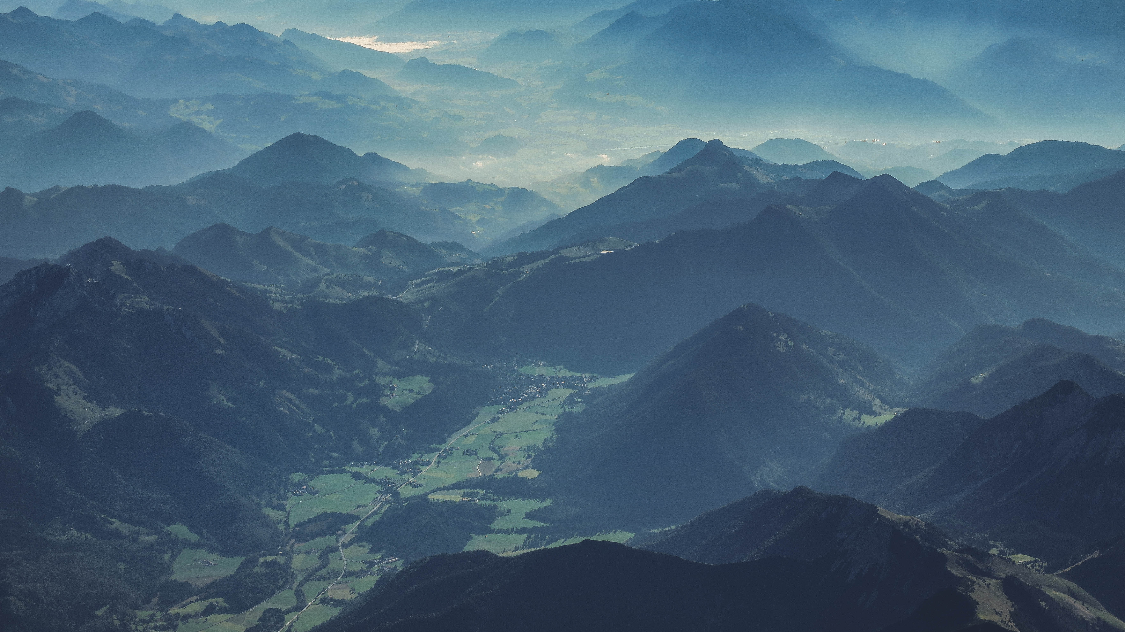
WELCOME TO THE BLUE MOUNTAINS

